Slide 1
FIRST Conduct and Safety

Slide 2
Hello!
General safety
Competitions
YPP

Slide 3
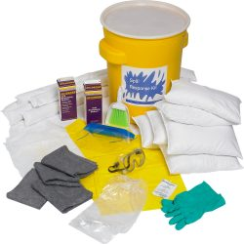
Battery Spill Kits:

Slide 4
Battery Spill Kits:
Gloves
Sand
Baking Soda
Sealed Container

Slide 5
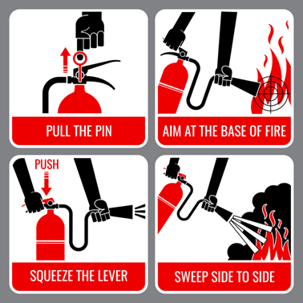
PASS:

Slide 6
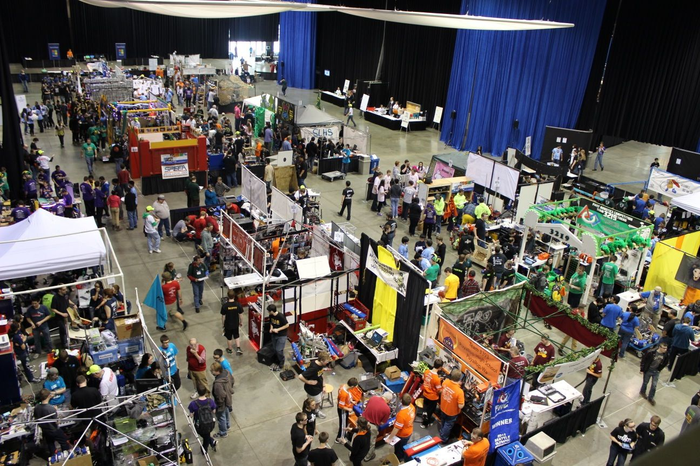
Competitions:

Slide 7
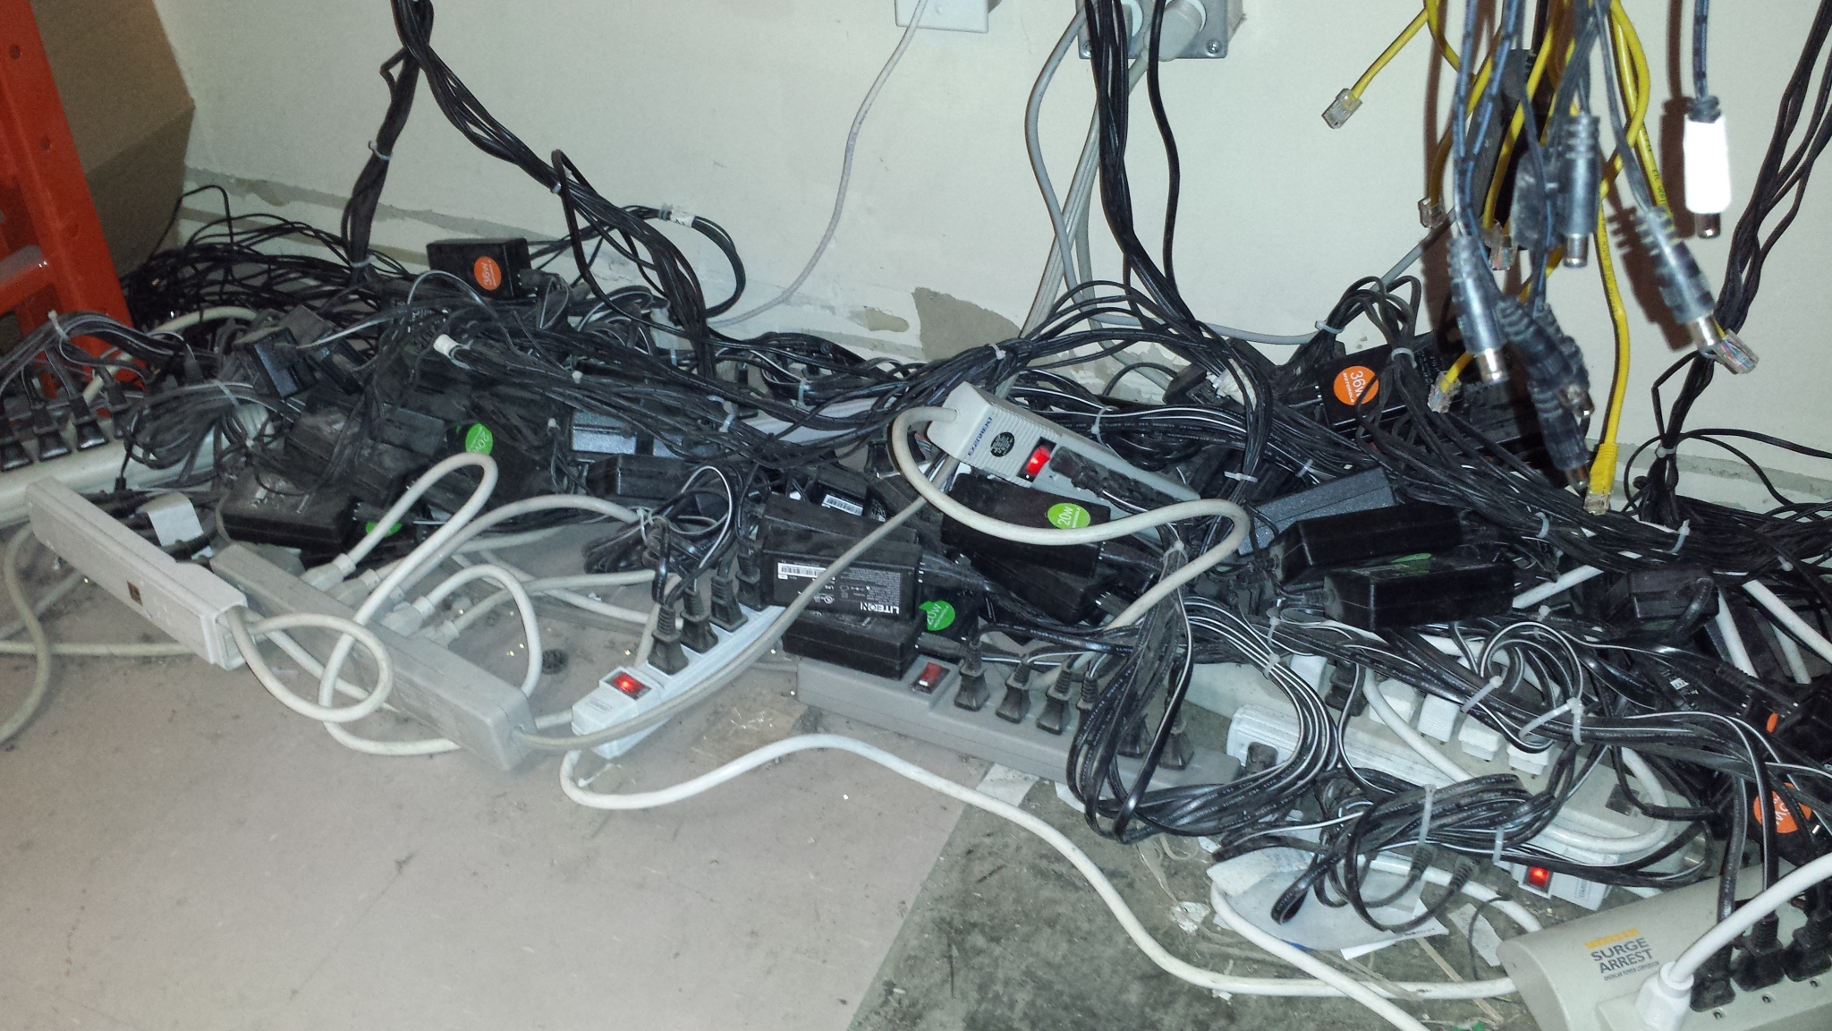
Competitions:

Slide 8
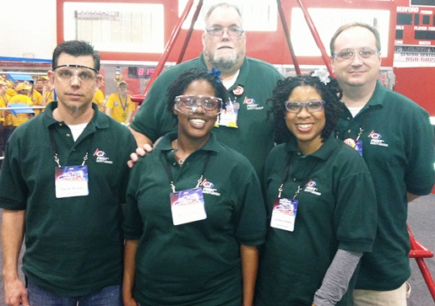
Competitions:

Slide 9
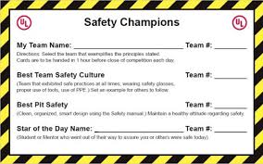
Competitions:

Slide 10
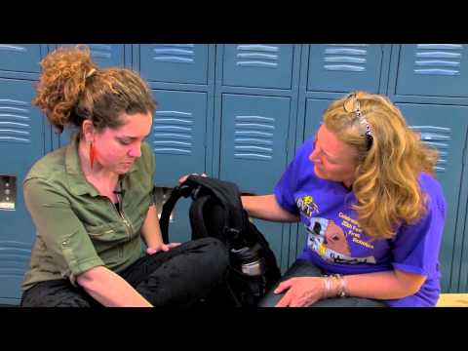
YPP:

Slide 11
Works Consulted:
DEPABLOS, KATHERINE. “Safety Supplies Unlimited.” Safety Supplies Unlimited, 17 Apr. 2018,
www.safetysuppliesunlimited.net/tips-on-how-to-use-a-fire-extinguisher/.
FIRST, Official, director. FIRST Youth Protection Video. YouTube, YouTube, 6 Aug. 2014, www.youtube.com/watch?v=Llm2mMV8WHs.
FIRST, Official, director. Youth Protection Policy- Guidance for FIRST Team Members - High School. YouTube, YouTube, 8 Dec. 2014,
www.youtube.com/watch?v=VPzxm4IfG6w.
FRC Staff. “2018 Safety Manual.” FIRST Inspires, FIRST, 2018,
www.firstinspires.org/sites/default/files/uploads/resource_library/2018-first-robotics-competition-safety-manual.pdf.
FRC Staff. “Awards Based on Team Attributes.” FIRST, Made with FlippingBook, 30 Oct. 2018,
www.firstinspires.org/resource-library/frc/awards-based-on-team-attributes.

Slide 12
Works Consulted:
FRC Staff. “FIRST Youth Protection Program.” FIRST Inspires, FIRST, www.firstinspires.org/sites/default/files/uploads/about/FIRST-YPP-ProgramGuide.pdf.
FRC Staff. “Youth Protection Program.” FIRST, Made with FlippingBook, 13 Nov. 2018, www.firstinspires.org/resource-library/youth-protection-policy.
Hall, Nicole. “10 THINGS NOT TO DO WITH MULTI-OUTLET POWER STRIPS.” 10 THINGS NOT TO DO WITH MULTI-OUTLET POWER STRIPS, Falconer Electronics, Inc.,
falconerelectronics.com/10-things-not-to-do-power-strips/.
Qualey, Shana. “Discover Ideas about First Robotics Competition.” Pinterest, www.pinterest.com/pin/286752701250363329/.
“Spill Kit 20 (SK-20).” Battery Spill Kits, BHS, na.bhs1.com/products/accessories/battery-spill-kits/.
Underwriter Laboratories. “UL Safety Smart Advisors Mentor FIRST Students.” Safety Smart, Underwriter Laboratories, 2013,
ulsafetysmart.com/content/show/193/parents.

