Slide 1
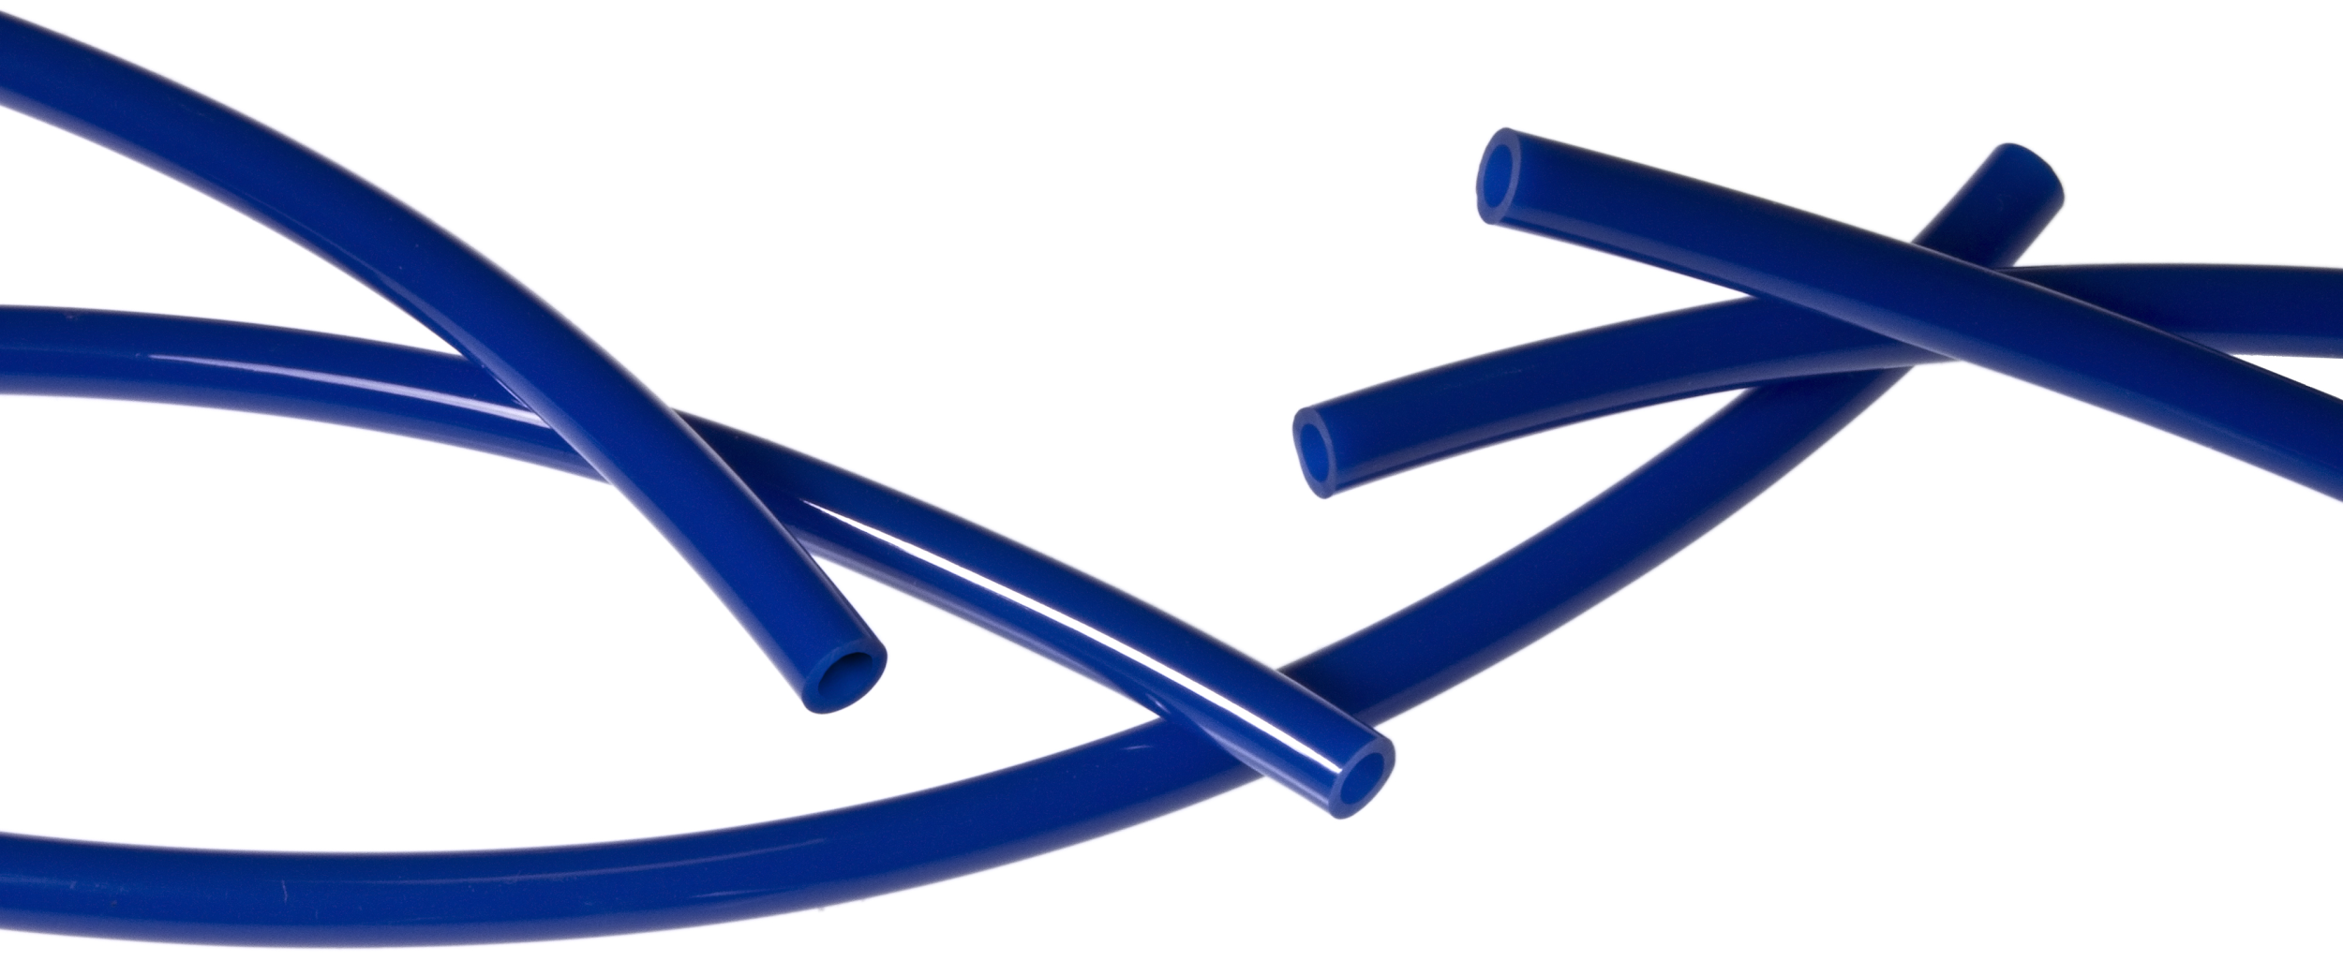
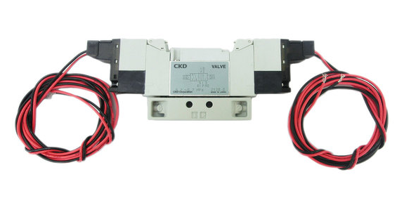
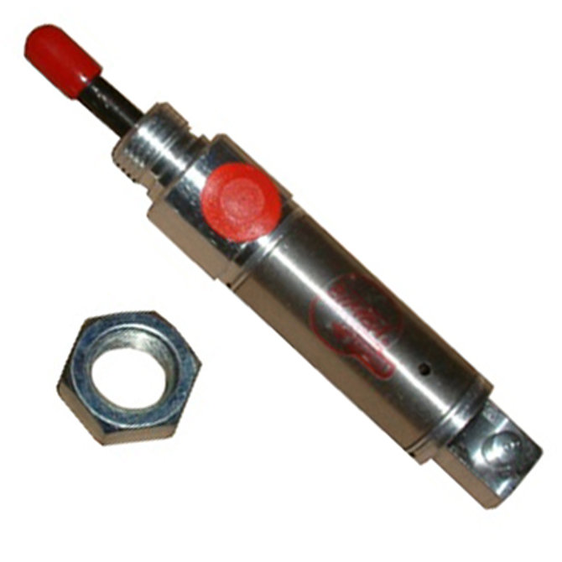
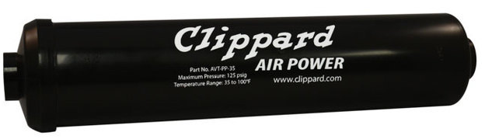
Intro to Pneumatics
By team 1418 (Vae Victis)

Slide 2
What is pneumatics?
“Pneumatics is a branch of engineering that makes use of pressurized gas to control physical systems. Pneumatics are used extensively on FRC robots using compressed air to create mechanical motion.”
“Lesson: Intro to Pneumatics.” STEMRobotics, stemrobotics.cs.pdx.edu/node/5210.

Slide 3
System Components
-Pneumatic Control Module (PCM) -Pressure Gauges
-Air Compressor -Solenoids
-Pressure Switch -Pneumatic Cylinders
-Pressure Release Valve -Tubing and fittings
-Storage tanks
-Emergency Relief Valve(Pressure Vent Plug)
-Pressure Regulator

Slide 4
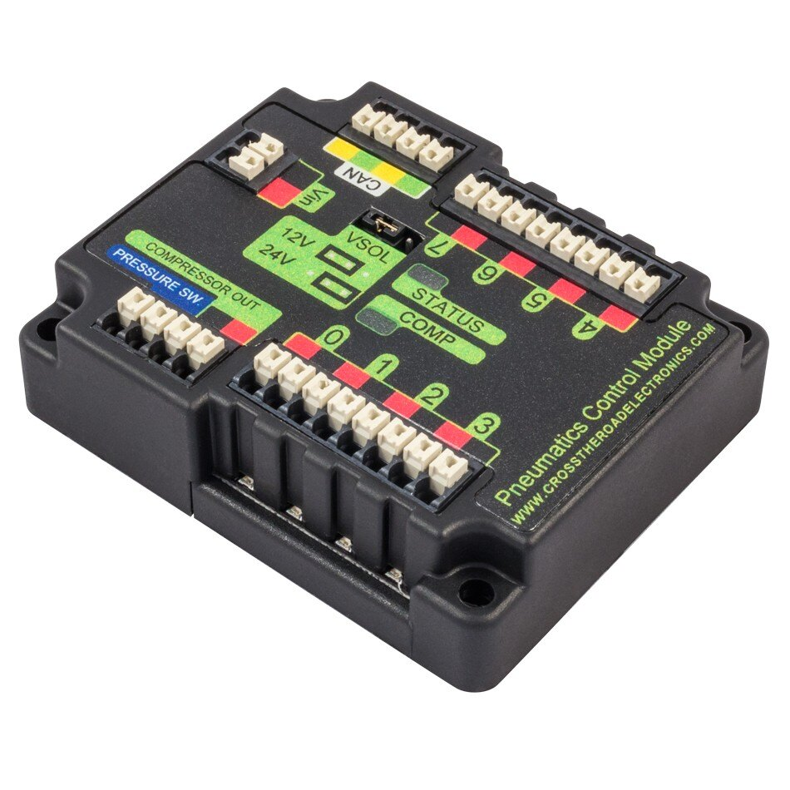
Pneumatic Control Module
-Allows control over the pneumatic system.
-Connects solenoids, compressor and pressure sensor to the RoboRio.
-Comes configured to operate 12v solenoids, but can be configured to operate 24v solenoids by moving the jumper from the left 2 pins to the right 2 pins.
-All solenoids on the PCM must operate at the same voltage.

Slide 5
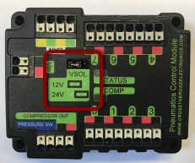
Wiring the PCM
CAN Connections
To the Power Distribution Panel
12V/24V Jumper
Solenoids
Compressor Power
v
Pressure Switch

Slide 6
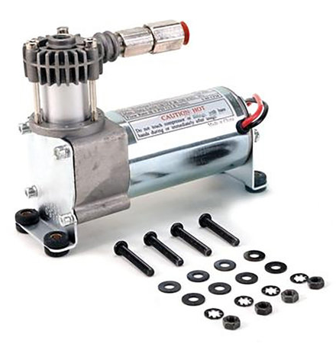

Air Compressor
Provides compressed air for the pneumatic system.
Controlled through the PCM.
1 compressor on a robot.
All compressed air MUST come from on onboard(mounted on the robot) compressor.
The compressor gets VERY HOT while running.

Slide 7
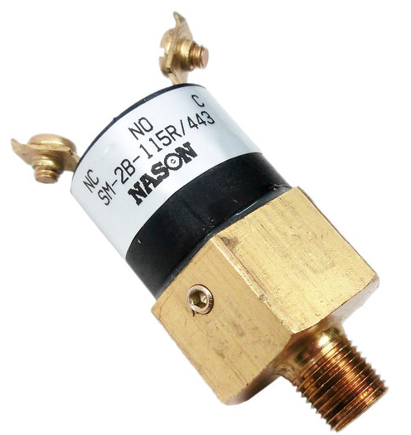
Pressure Switch
-Opens at 115-120 psi, closes at 95 psi.
-Used to disable the compressor once the system has reached a certain pressure.
-Connected to the PCM.
-Must be placed on high pressure side of system.

Slide 8

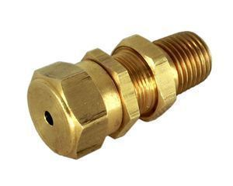
Pressure Relief Valve
-Opens once the system pressure reaches a certain threshold.
-Helps to prevent system pressure from increasing beyond what the system components are rated to withstand.
-Must be connected to the compressor with rigid fittings.
Norgren Valve- Adjustable pressure
McMaster-Carr Valve-non adjustable 125 psi

Slide 9
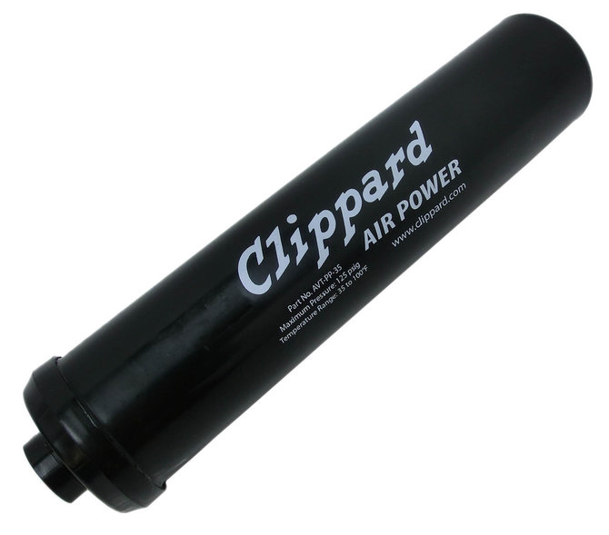
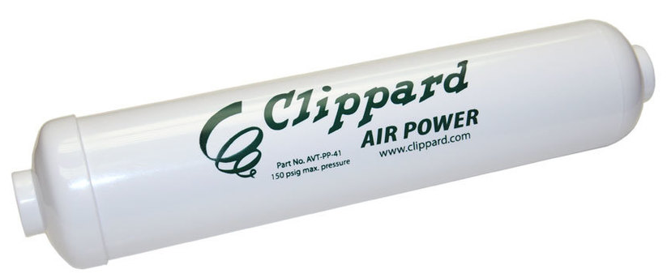
Storage Tanks
-Store compressed air for the system.
-More tanks = greater air capacity + longer fill times
-No official restrictions on mounting, as long as the tanks are secure(not shifting around) and not damaged.
-Methods 1418 has used include velcro straps, strap clamps and 3d printed brackets(not used in competition)
Teams are prohibited from using White Clippard tanks P/N: AVT-PP-41

Slide 10
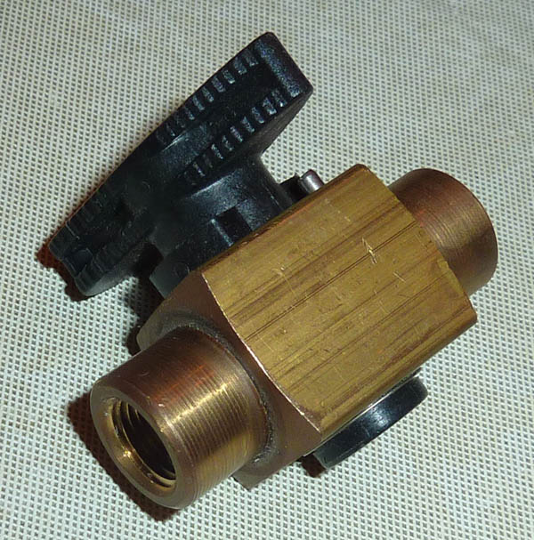
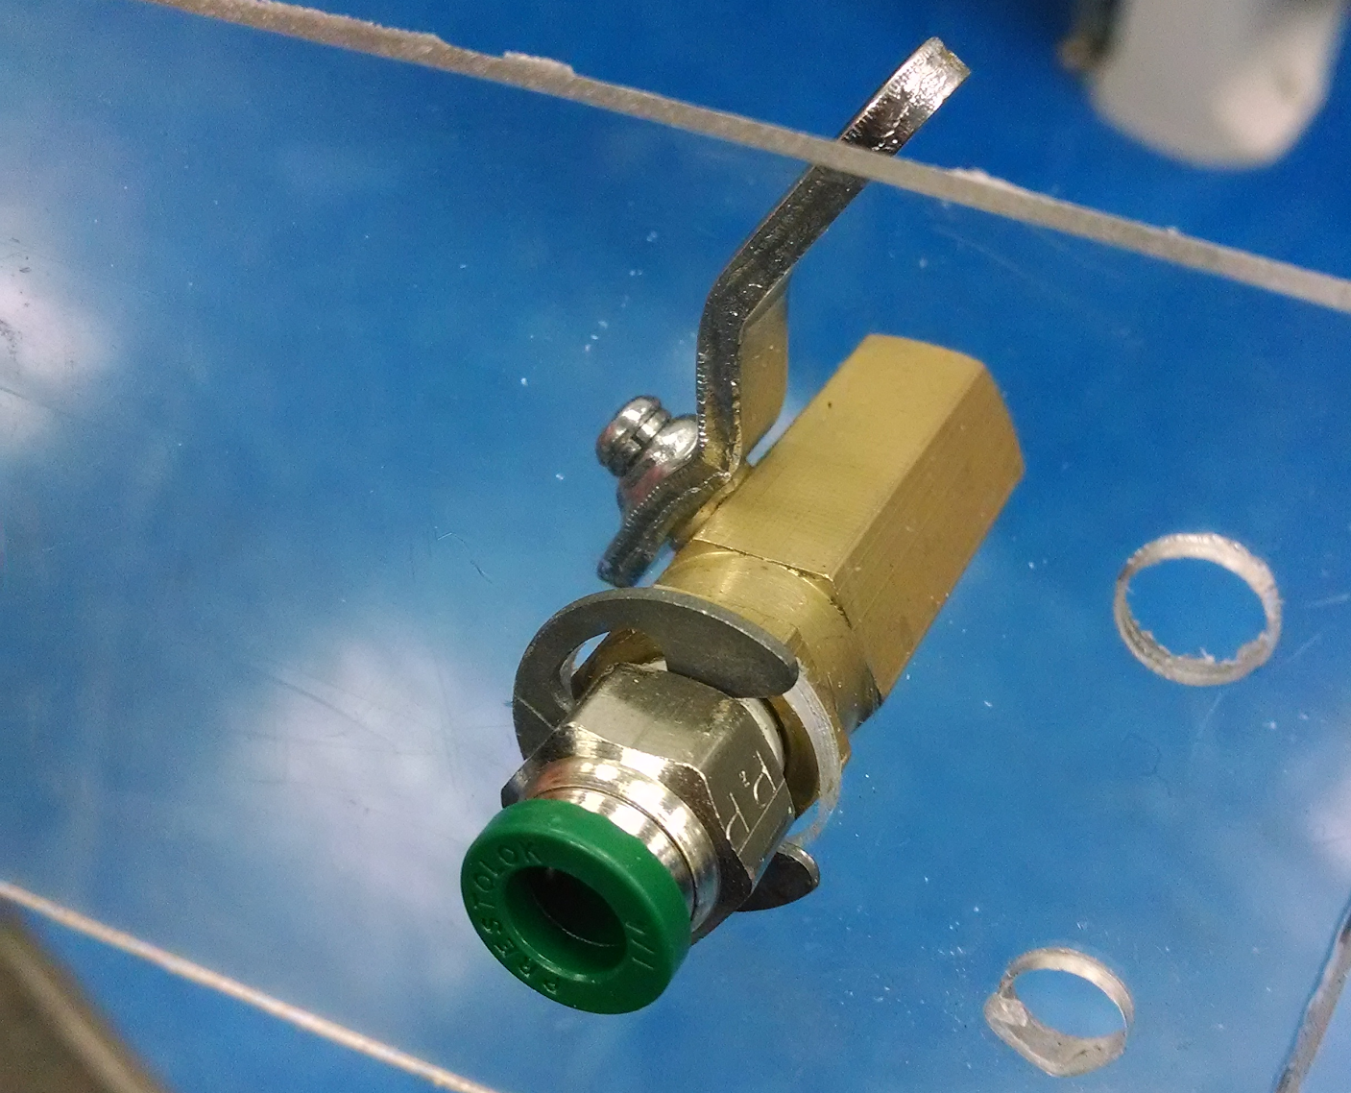
Emergency Relief Valve(Pressure Vent Plug)
-Used to rapidly depressurize the pneumatic system.
-Must be clearly visible and easily accessible.
-Can be placed on the high or low pressure side of the system.

Slide 11
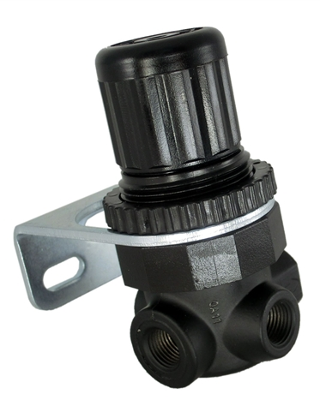
Pressure Regulator
-Used to limit the pressure of working components.
-Separates the stored(high) pressure side of the system from the working(low) pressure side.
-Working pressure can be adjusted by pulling and rotating the upper portion of the regulator(max 60 psi)
-Output is the longer port marked with an arrow, the opposite port is the input.

Slide 12
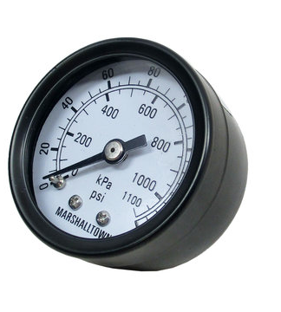
Pressure Gauge
-Display pressure level of the system
-Must have one gauge measuring stored pressure.
-Must have one gauge measuring working pressure.
-Gauges must be easily visible.

Slide 13
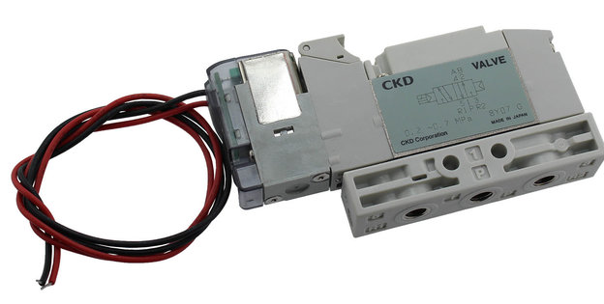
Solenoids
-Controls flow of air to connected cylinders.
-Connected to PCM.
-Single Acting solenoids apply or vent pressure from one output port.
-Double acting solenoids switch air pressure between two different output valves.

Slide 14
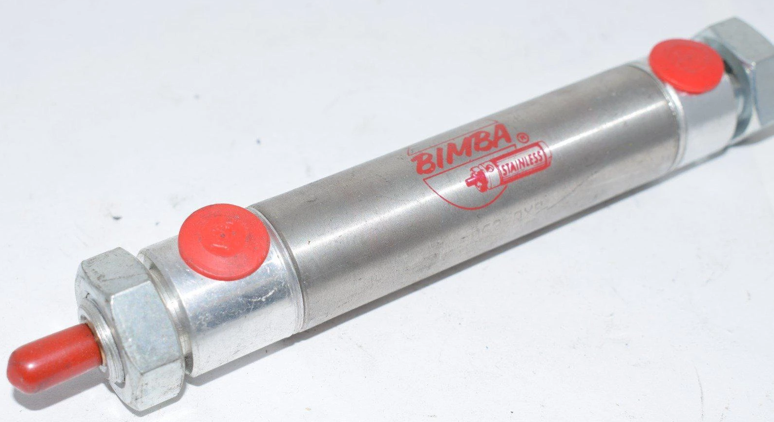
Pneumatic Cylinders
-Convert energy of compressed air into mechanical energy.
-Provide linear motion.
-Single Action Cylinder -One air input, have a spring that retracts the shaft when pressure is removed.
-Double Action Cylinder- Two inputs, no spring, uses air to extend and retract. Shaft will stay extended or retracted until air is applied to the opposite input.

Slide 15
Picking the right Cylinder
Stroke: Distance the rod moves while extended or retracting.
Bore: Diameter of the cylinder.
Force=Pressure x Area
-Larger bore size provides more force, but will need more air. Longer stroke also consumes more air per extension or retraction.
Bore
Stroke Length

Slide 16
Additional Cylinder Options
Port placement: rear port- second port is placed on the back side of the cylinder
Side port- second port is placed on the side of the cylinder.
Extra Extension: Additional length added to the end of the cylinder rod.
Extra Extension

Slide 17
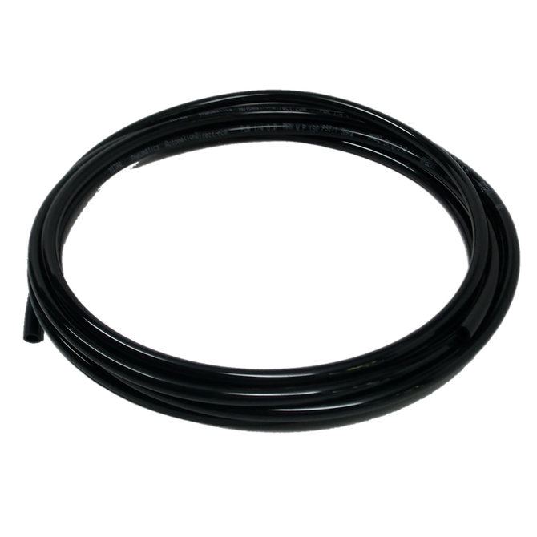
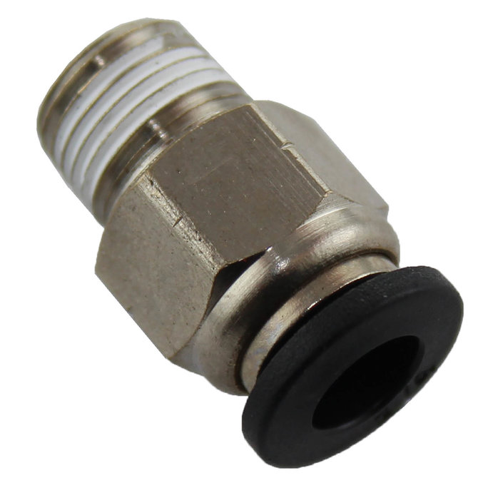
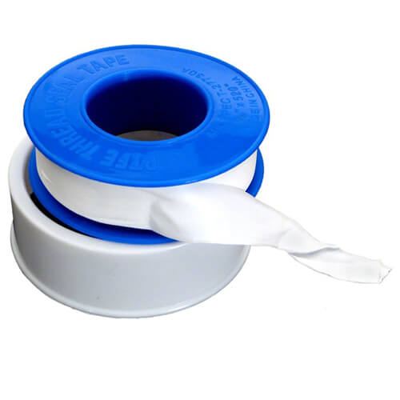
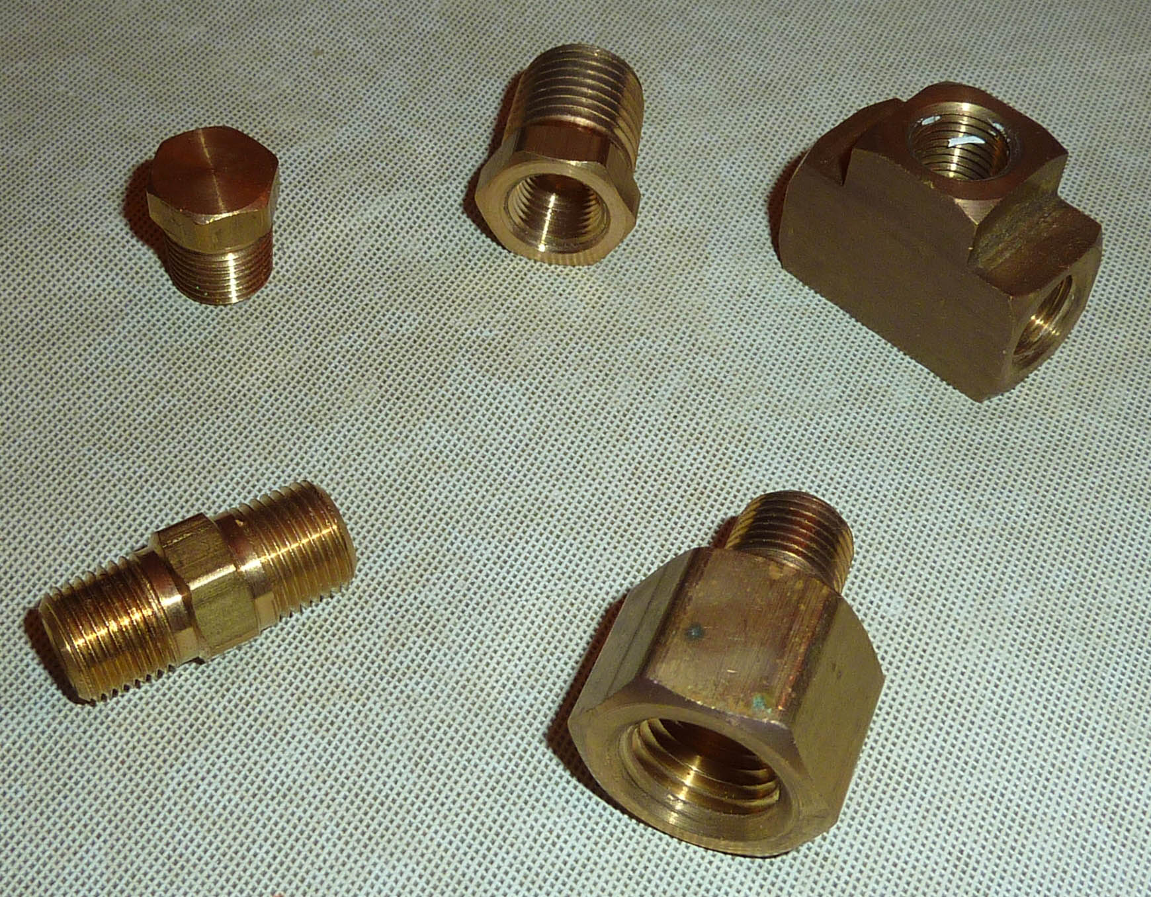
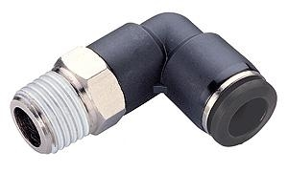
Tubing and Fittings
-Used to connect other pneumatic components.
-When connecting fittings to other component or other fittings, use teflon tape to ensure a good seal.

Slide 18
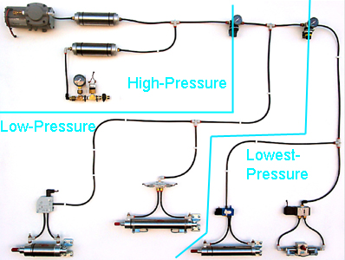
Putting it all together
Image by team 358

Slide 19
Problem Solving
-Pressure not building/losing pressure (leaks)- Most common problem, easy to solve
-Usually the result of a tube not being fully pressed in or a fitting not tightened enough/not sealed properly. Or not closing the emergency relief valve. Yes, it happens sometimes.
-find leak- feel along all components or listen for rushing air.
-tighten any leaking components, if a component is tightened and still leaking, try replacing, the component itself may be damaged.

Slide 20
-Compressor not shutting off- Usually a problem with the wiring on the pressure switch.
-Ensure that the pressure switch wires have not been pulled out of the PCM.
-Check wire connections on the pressure switch.
-Compressor not turning on- usually an issue with the connections to the PCM, or the PCM connections to the power distribution panel.
-Check that all wires are fully inserted into the PCM and PDP.
-Nothing is working- Usually an issue with the PCM
-Check status lights on the PCM- if not on, check connection to PDP.

Slide 21
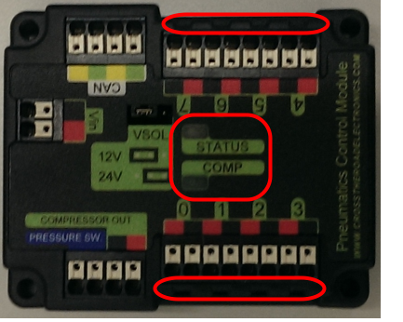

Slide 22
Rules
DISCLAIMER-These are current as of the 2019 season, and are subject to change in 2020.
- Pneumatic rules are listed in R81-R94 in the game manual.
-All parts rated for 125 psi, or on the low pressure side and rated for 75 psi
-No modifying components- Exceptions for cutting tubing, connecting parts using threads, changing mounting hardware, labeling, etc.
-Pressure MUST be generated using ONBOARD compressor- No external source
-120 psi max stored, 60 psi max working
-No connecting solenoid outputs together

